Slide 1

30th May, 2018
Mentor:
Dr Singara Singh
Associate Professor
CSED, TIET
Team Members:
Akshay Sharma | 101683035 | COE 1
Abhi Mahajan | 101683033 | COE 1
Abhishek Sharma | 101503008 | COE 1

Slide 2
Project overview
Pianos are large instruments that need to be carried in a large bag and are prone to damage.
Portable virtual piano that just uses semi-transparent plastic sheet.
Detect human fingers through plastic sheet & simulate associate piano tone for each section to play piano tones using a speaker
Approved Objectives
We propose a portable virtual piano that just uses semi-transparent plastic sheet that can be carried anywhere and does not have any electronic components in it.
Virtual Pianos will be much cheaper than traditional pianos.
It will help young children to get a feel for music and will act as a stepping stone for some of the world’s greatest artists.

Slide 3
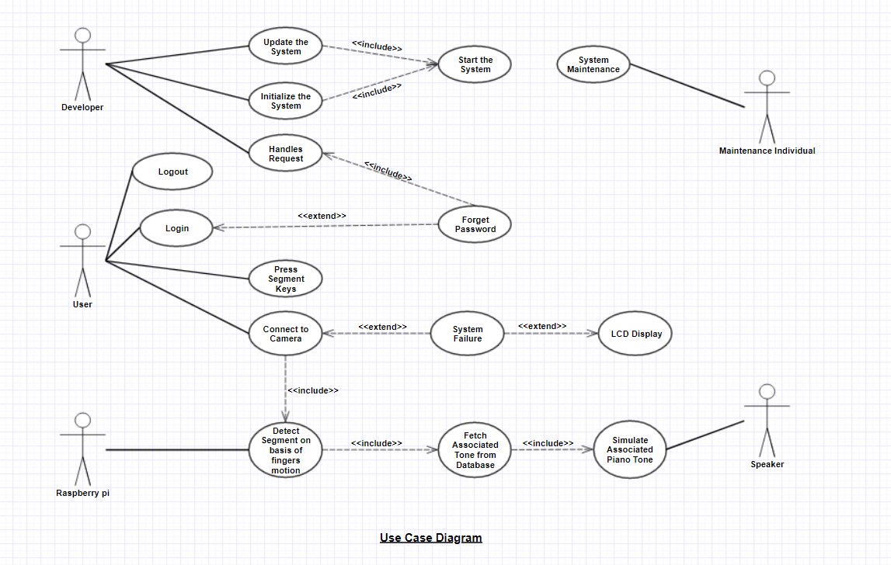
Use-Case Diagram

Slide 4
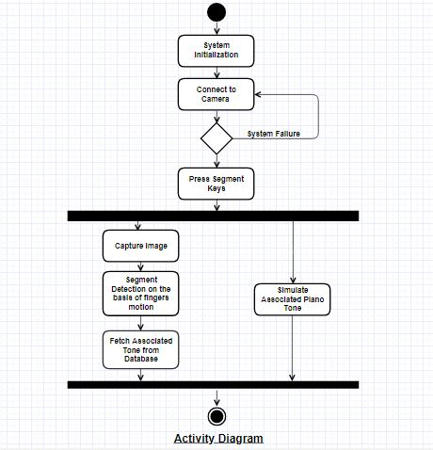
Activity Diagram

Slide 5
Tools Used
Raspberry Pi - The Raspberry Pi is a low cost, credit-card sized computer that plugs into a computer monitor or TV, and uses a standard keyboard and mouse.
Camera – To capture the real time motion of fingers.
Speaker – To simulate the piano tones.
Transparent Sheet – A virtual keyboard for user to press the segment key.
LCD Display - To display working status of the piano.
The best team is where
the best leader be

Slide 6
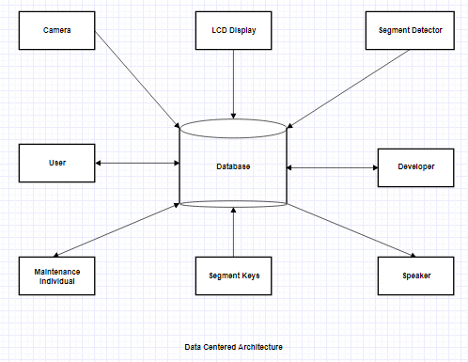
Data Centered Architecture

Slide 7
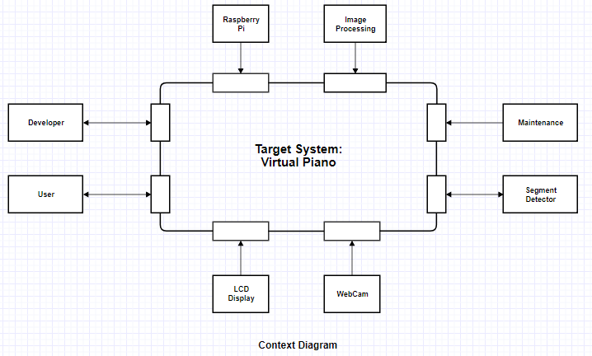
Context Diagram

Slide 8
Cost Analysis
Raspberry PI: | ₹ 3,649.00 | Digital Multimeter: | ₹ 250.00
PCB Board: | ₹ 185.00 | LCD Display: | ₹ 1410.00
SD Card: | ₹ 599.00 | Wire stripper & cutter: | ₹ 58.00
Speaker: | ₹ 200.00 | Miscellaneous: | ₹ 499.00
Webcam: | ₹ 850.00
Soldering Iron: | ₹ 299.00
Total | ₹ 7999.00

Slide 9
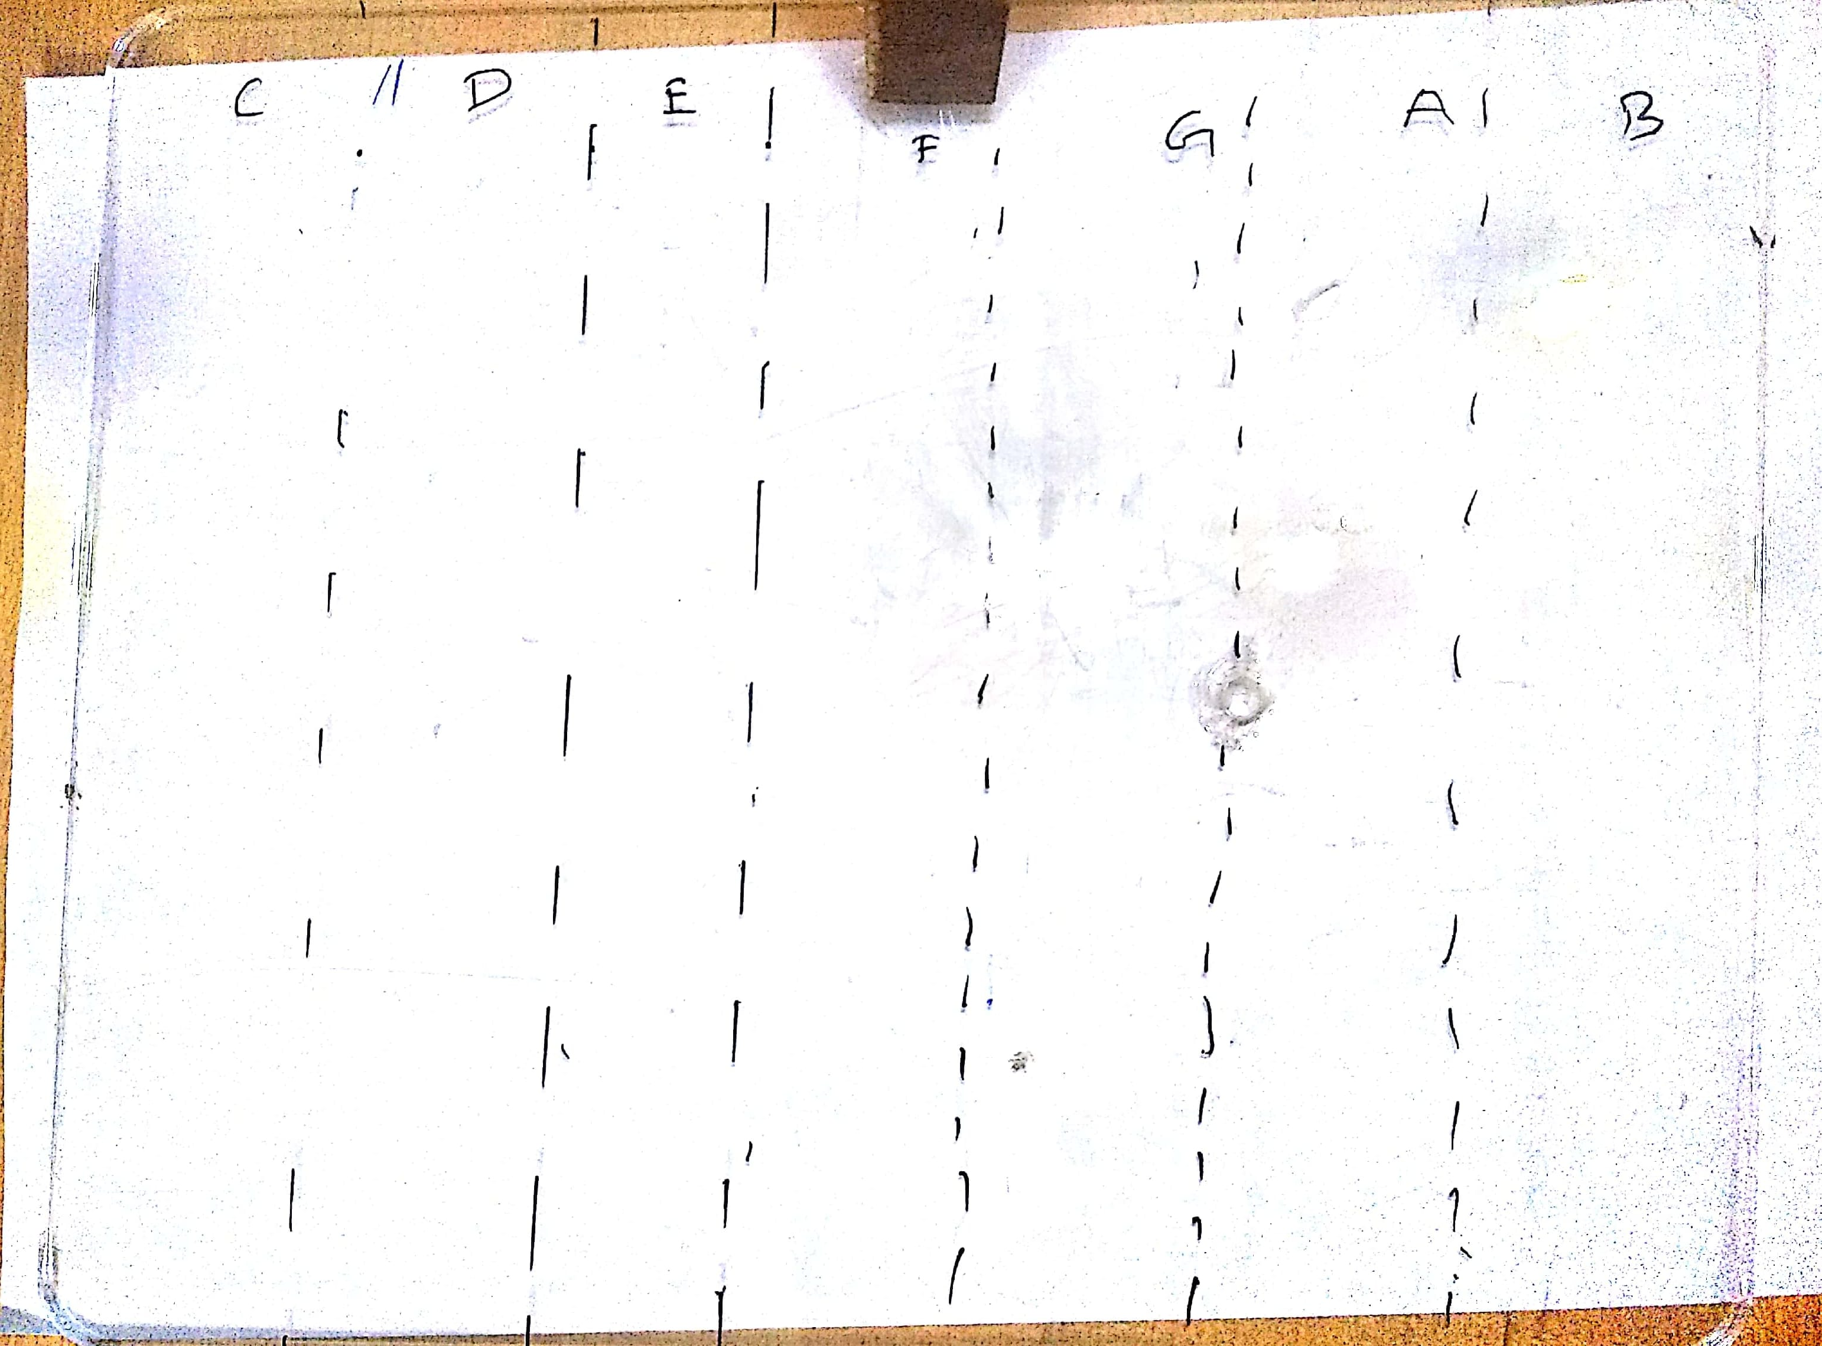
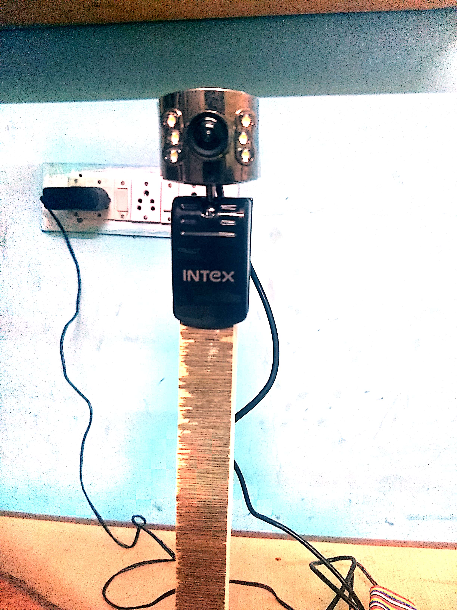
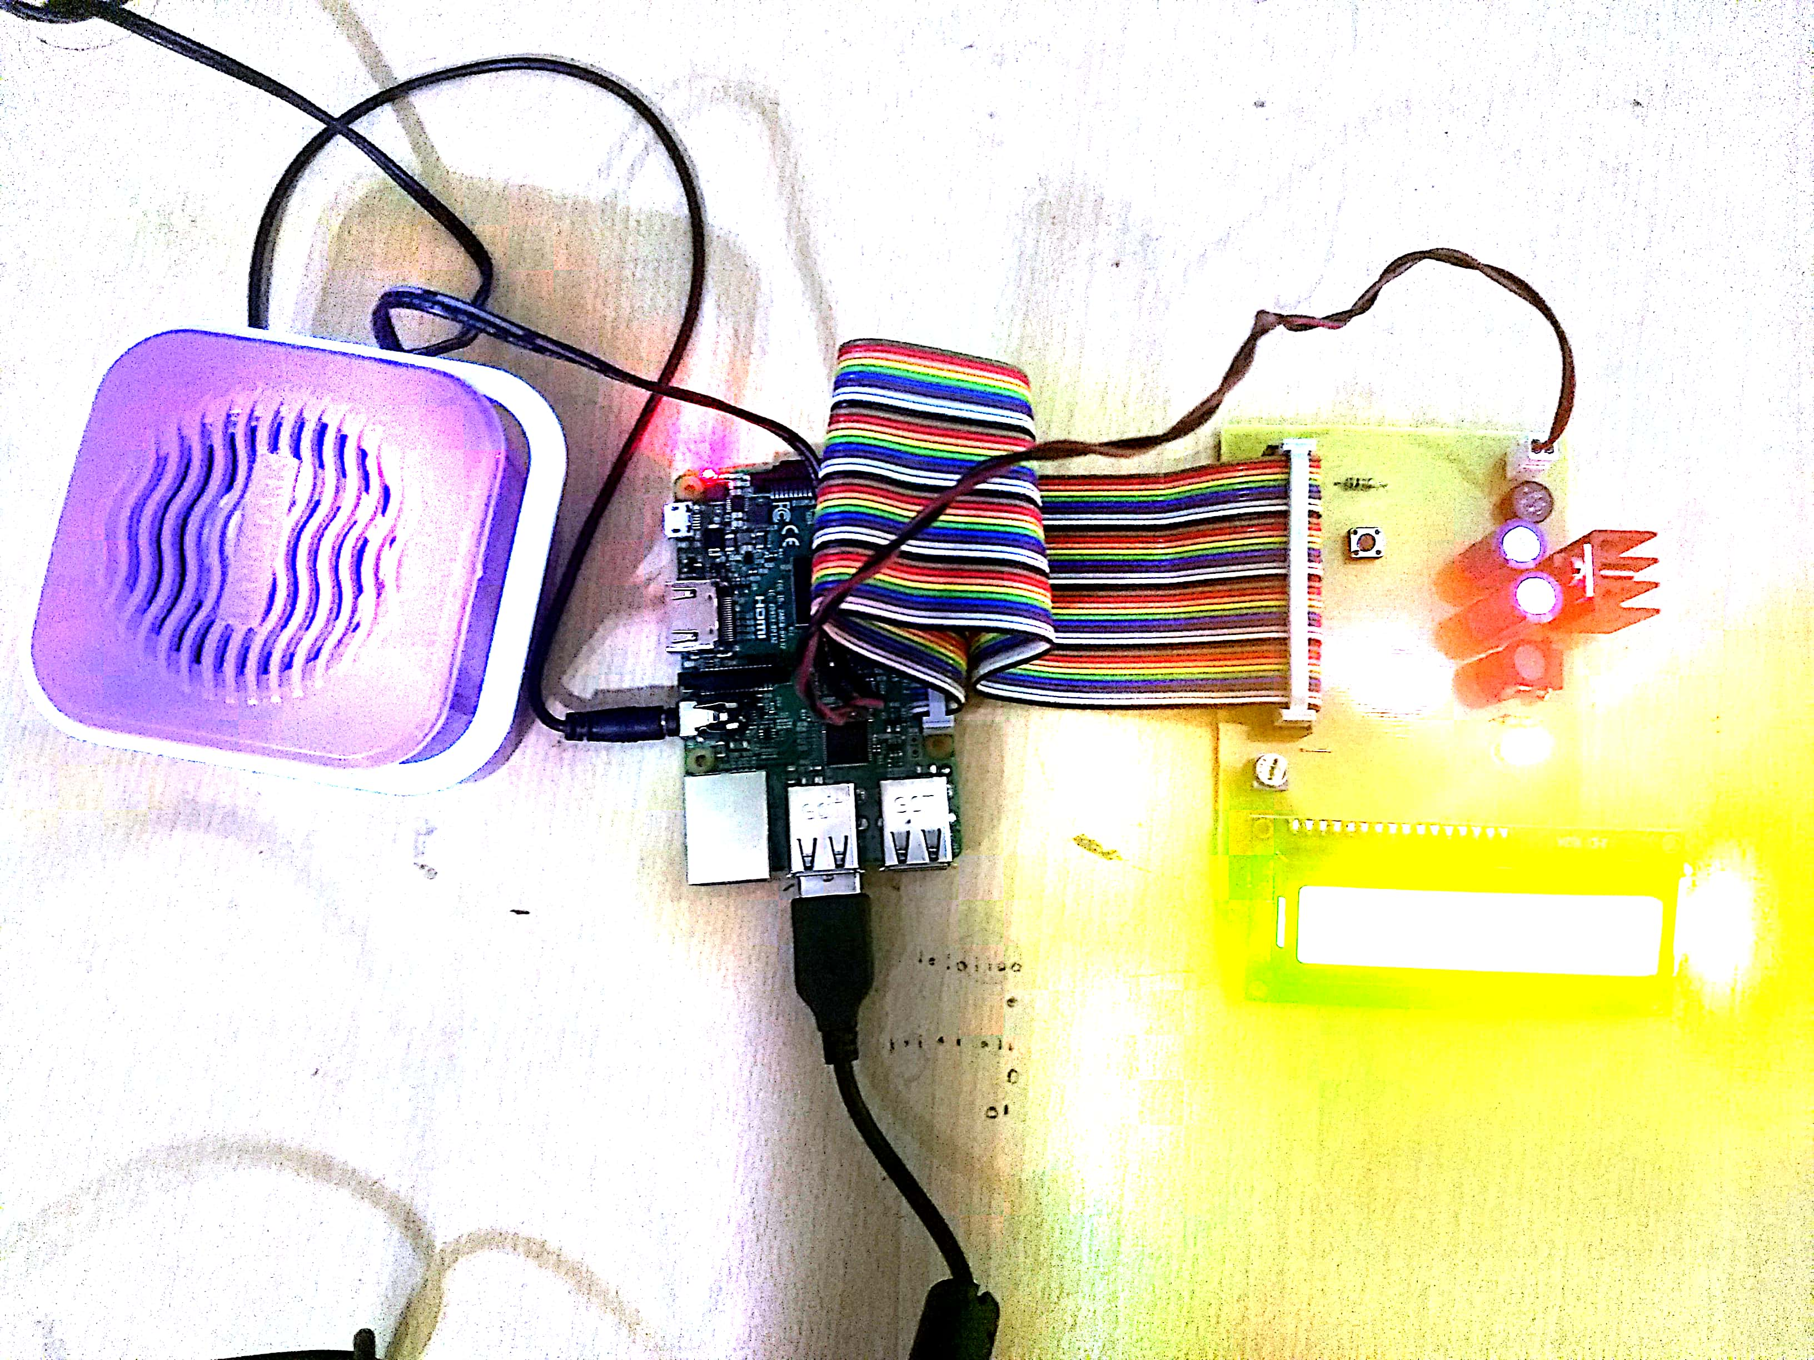
Outcomes

Slide 10
Project Execution Completed
1.
4.
3.
2.
System Design
Hardware
Assembled
Implemented
Real Time sensing
Simulate piano tones
Created the architecture for our project
Procured & assembled hardware based on system design specification
Finalized the implementation of real time sensing algorithm
Simulate associated piano tone based on the detected segment

Slide 11

Future plans
Code optimization to improve real time sensing.
Improved prototype with proper casing to give it a finishing and premium piano look.
Investigate using other real time sensing algorithms in OpenCV which might be more robust to varied lighting or other conditions.

Slide 12
Thank
You

